Slide 1


SQL
ROAD ACCIDENT ANALYSIS
SQL Server Management Studio

Slide 2

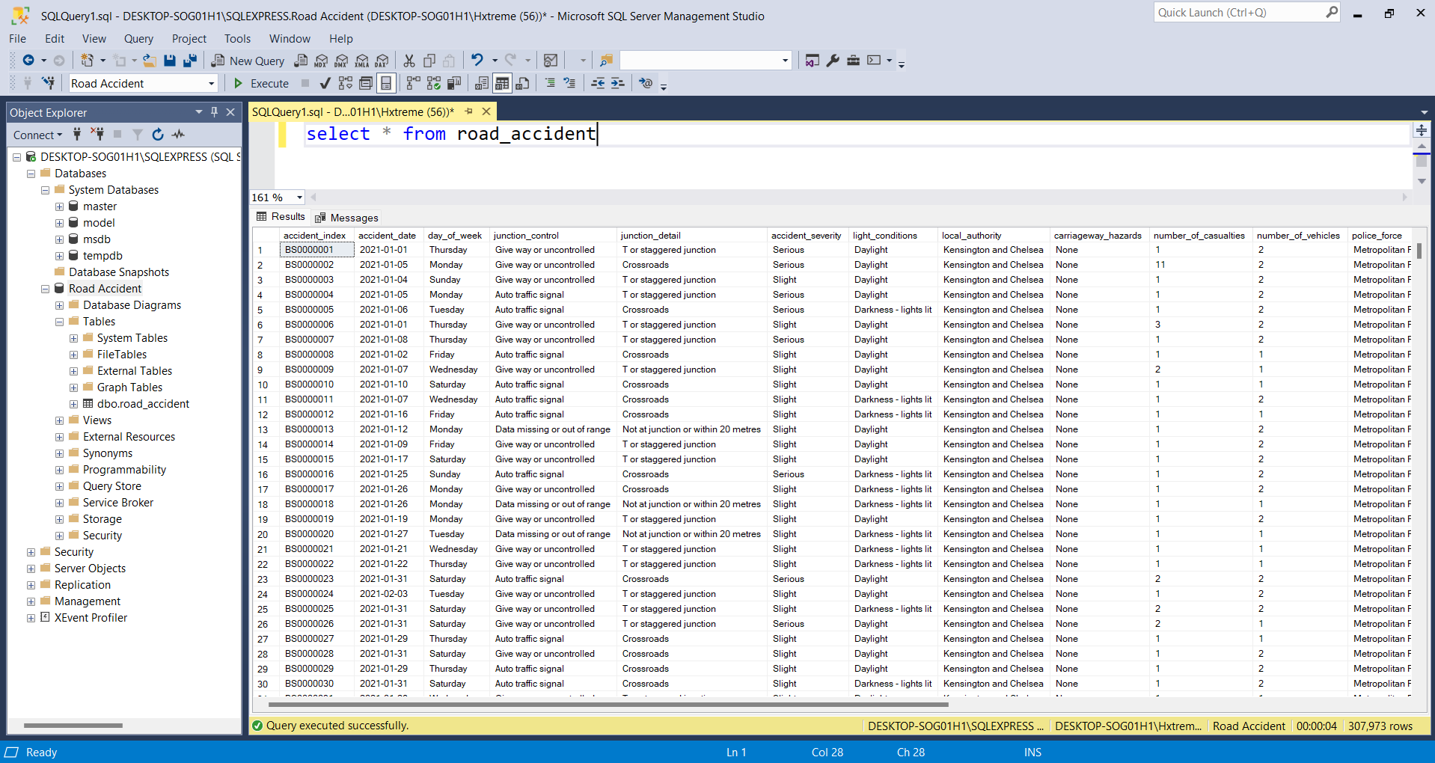

Slide 3

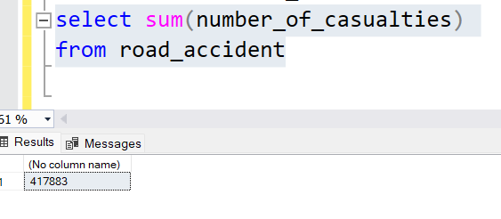
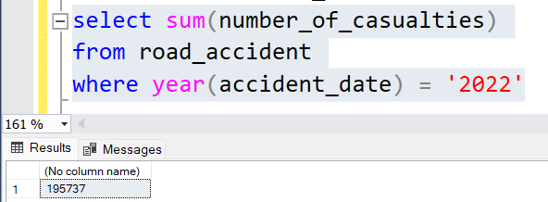
Total Casualties
Total Casualties
On 2022

Slide 4

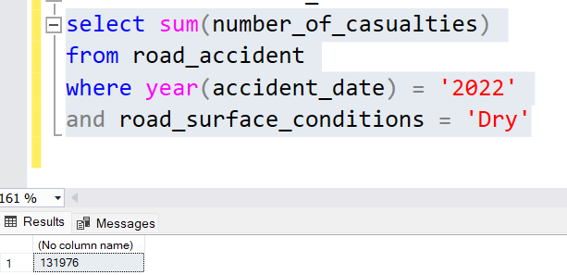
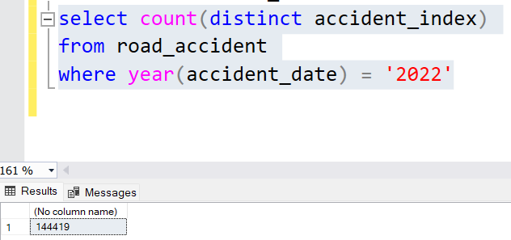
Total Casualties
On 2022
by Road Condition

Slide 5

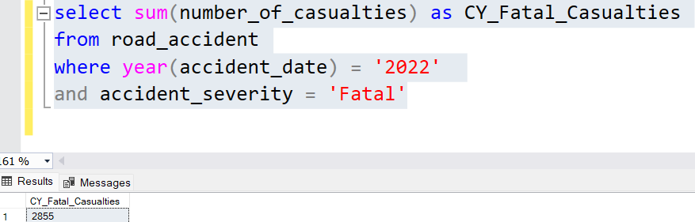
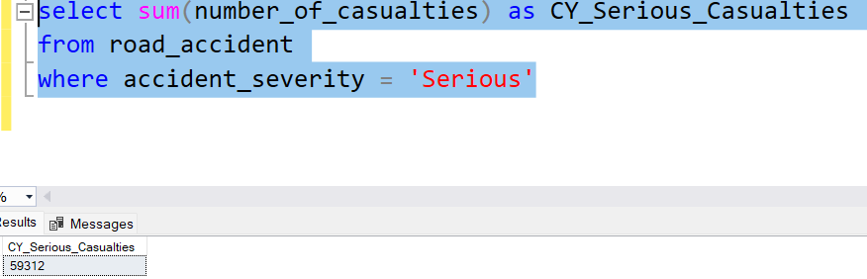
Total Casualties
On 2022
by Accident Severity
Total Casualties
by Serious Severity
Condition

Slide 6

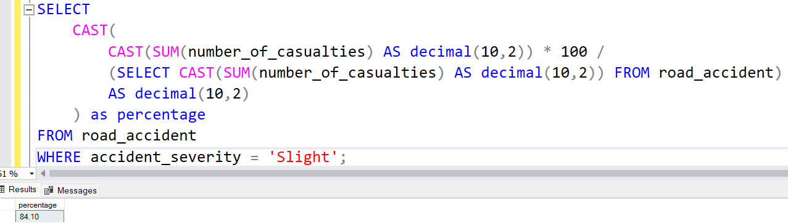
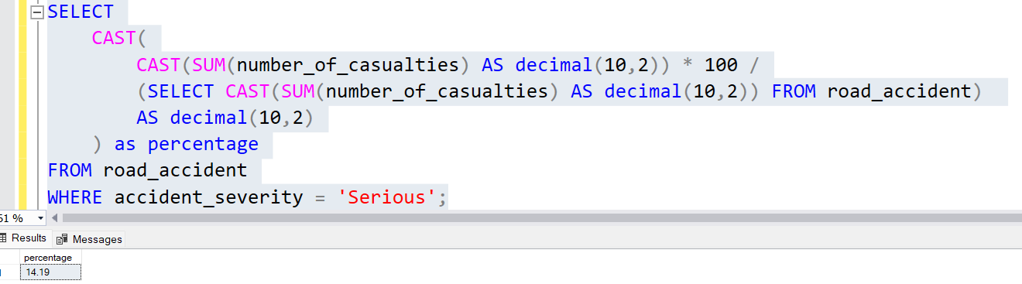
Total Casualties On 2022 by Accident Severity in Percentage

Slide 7

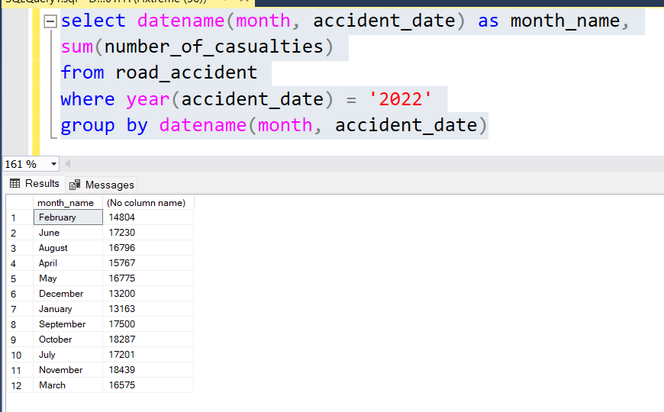
Total Casualties
By Month Wise
on 2022

Slide 8

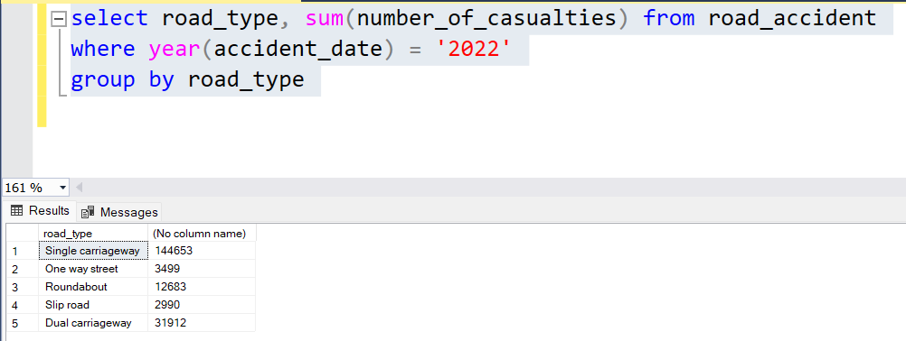
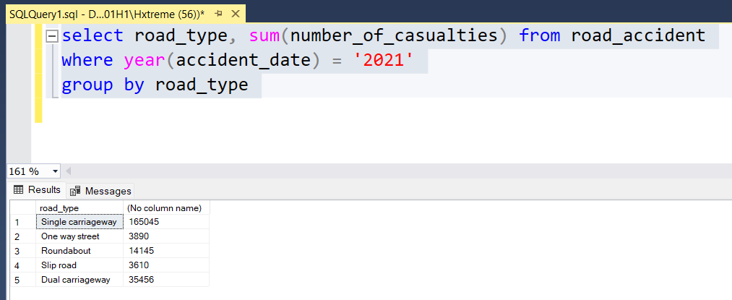
Total Casualties By Road Type

Slide 9

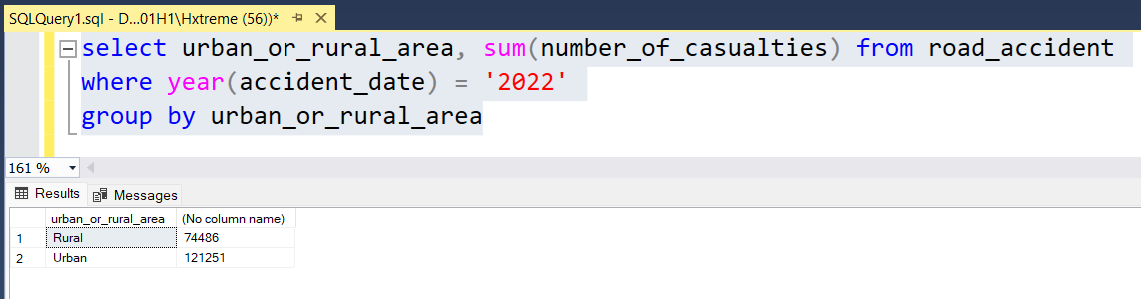
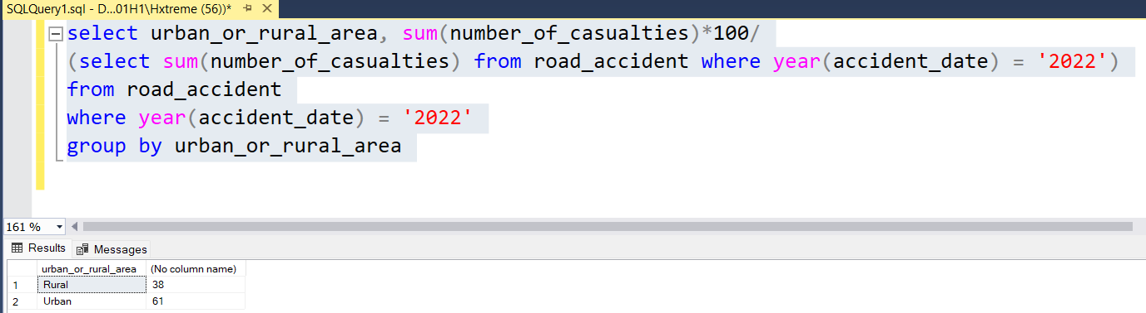
Total Casualties by Urban & Rural

Slide 10

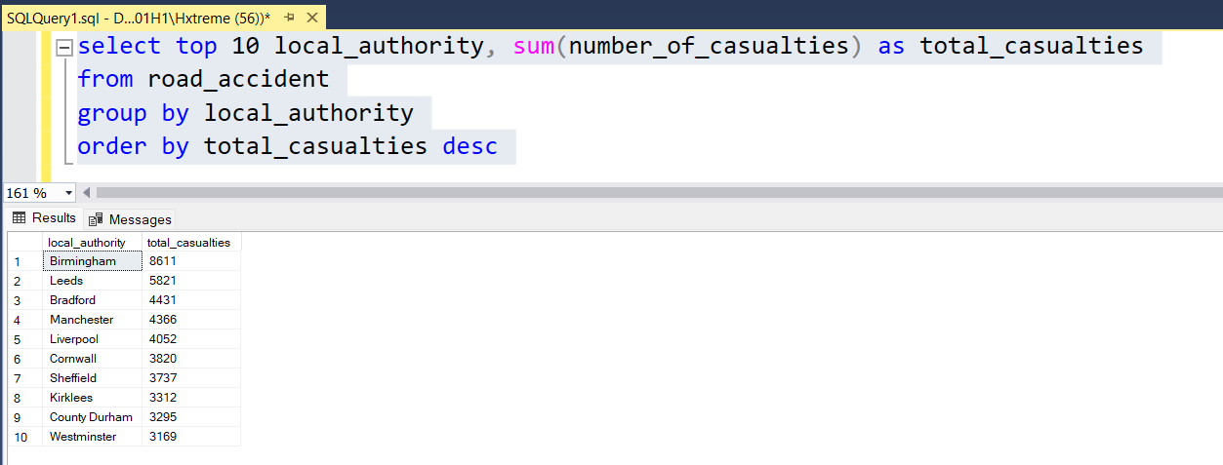
Top 10 Casualties By Location

Slide 11

THANK
YOU

